Slide 1
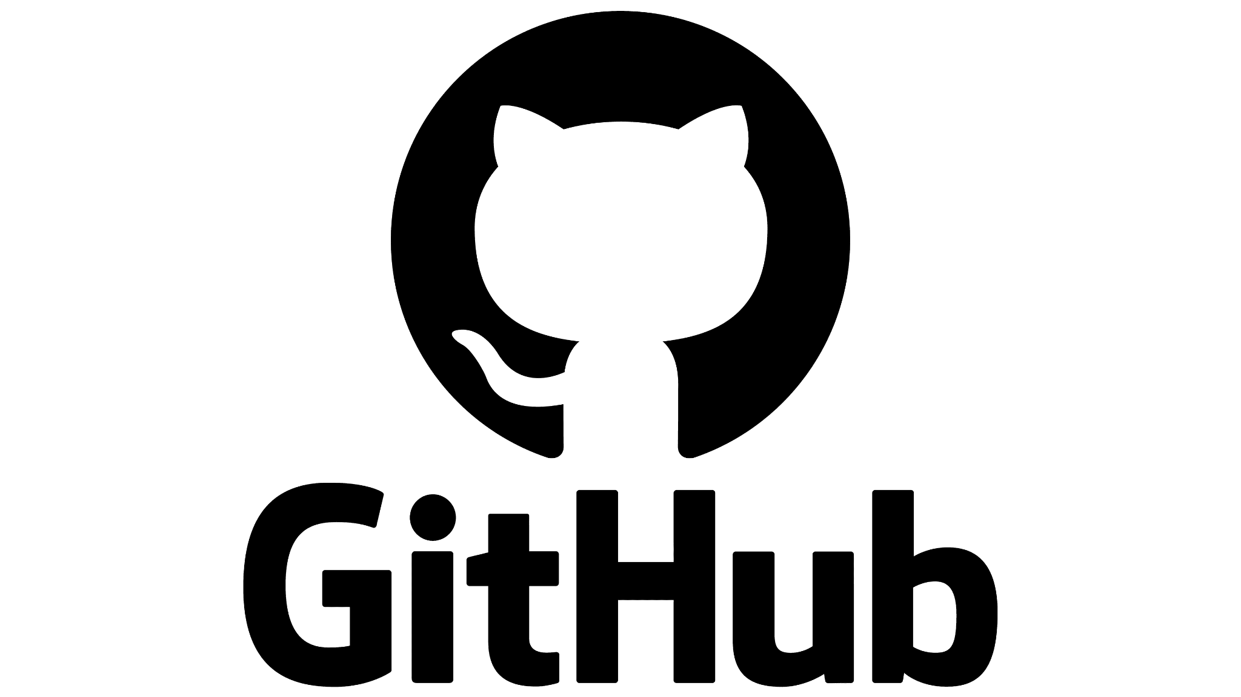
Collaboration Network
Analysis
By Faith Sang
Tuid: 916528214
Email: faith.sang@temple.edu

Slide 2
Introduction
Github is the world’s largest open-source platform, enabling millions of developers to collaborate through code sharing, forking and following.
It has revolutionized open-source collaboration, connecting developers globally through shared code and diverse programming languages.
While collaboration with in single language communities is well-studied, cross language contribution remains unexplored.

Slide 3
Aim & Objectives
This project investigates how developers works across multiple programming languages and how some act as bridges between distinct language communities.
By modelling a GitHub as a social network we aim to uncover:
The structure & patterns of collaboration
Key contributors (developers)
Impact of multilingual collaboration on software development

Slide 4
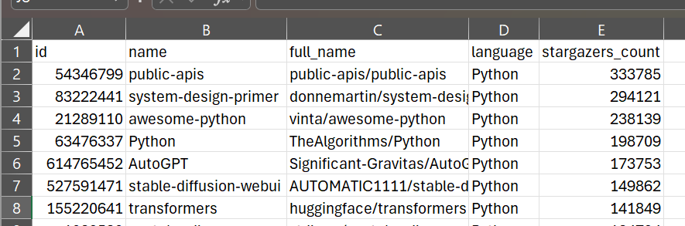
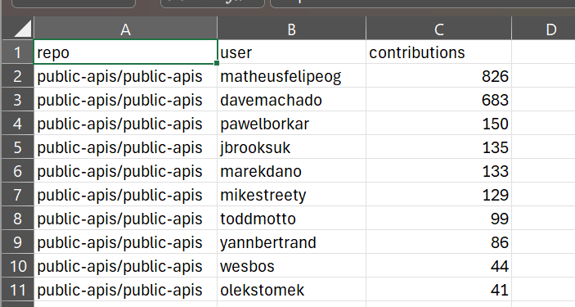
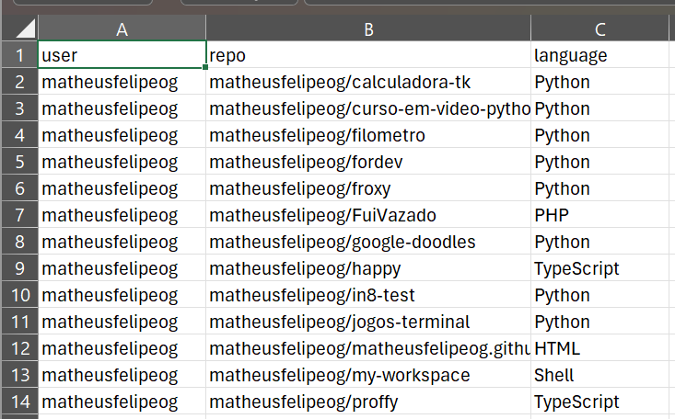
Data Collection
Data was collected through the GitHub REST API.
A query was done to get the top 100 starred repositories written in PYTHON
For each repository we fetched top 10 contributors based on their number of contributions. (989)
We retrieved all public repositories associated with each contributor.
For each repository we extracted primary language used 14,310(build multilingual profile)

Slide 5
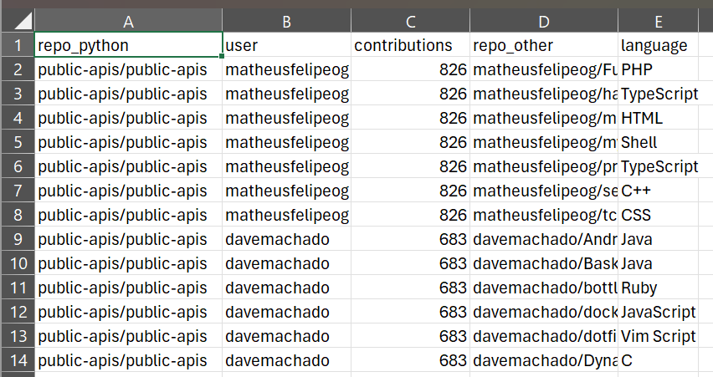
Pre-processing
Merged the datasets to match contributors from the original Python repos with the other languages they had works with.
Our focus is on cross-language contributions, we filter out repositories where the language was python.
Data contained supporting tools like Jupyter Notebook marked as programming languages. This was filtered out
The cleaned data is now what was used for analysis.

Slide 6
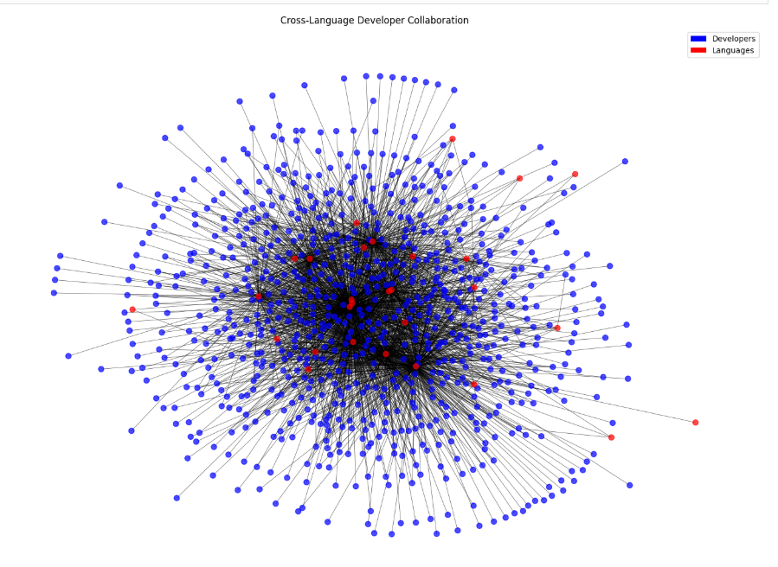
Heterogeneous Graph
Two distinct set of nodes
Developers
Programming languages
Edges connect to nodes of different types( developer to language)
Graph with 844 nodes and 2461 edges.

Slide 7
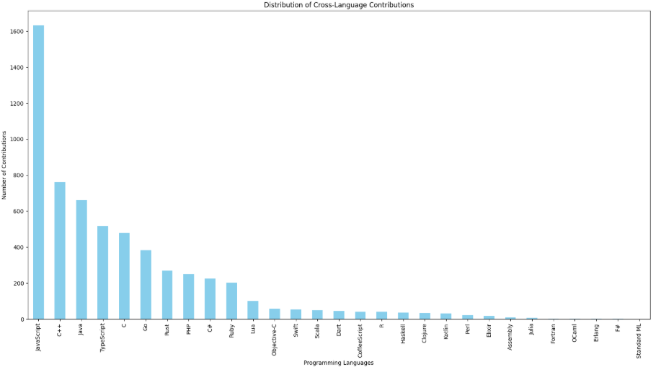
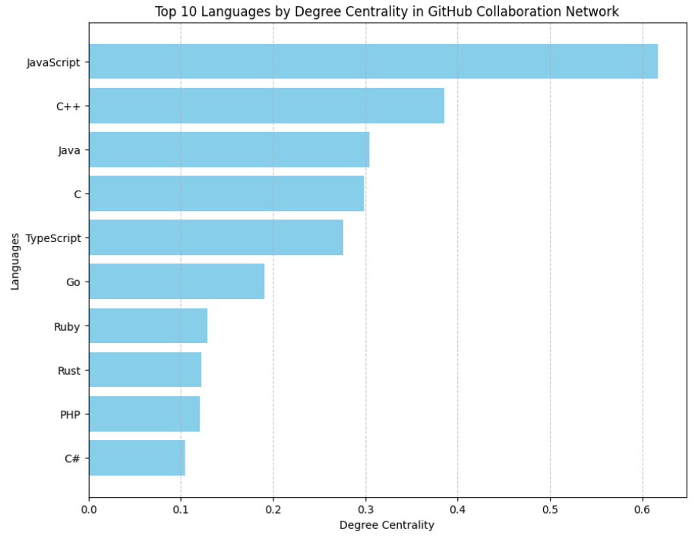
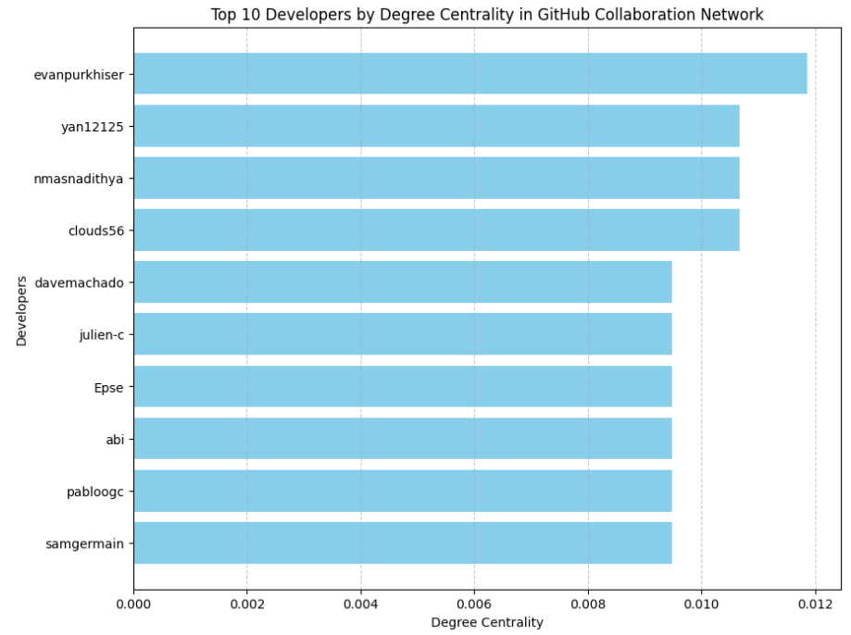

Slide 8
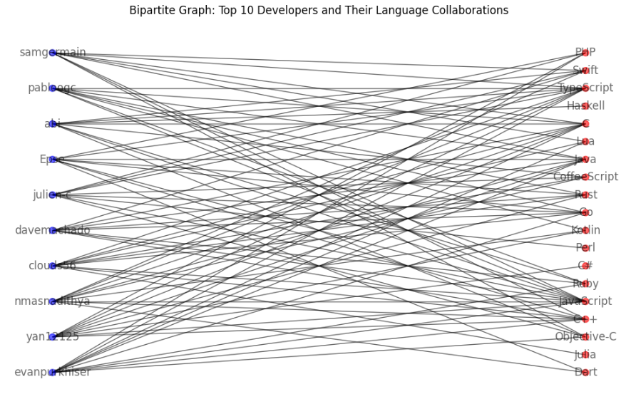
From the graphs we observe:
Influential connectors: Developers that are highly active and influential in the GitHub community.
Top Languages: The languages that many Python developers also work with
Top 10 developers are not confined to a single language rather actively contribute across different domains.

Slide 9
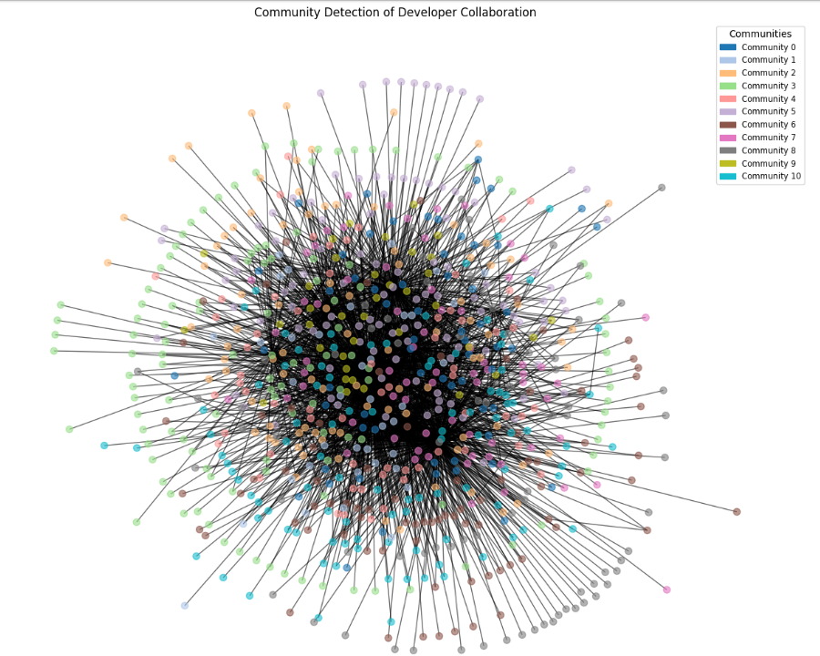
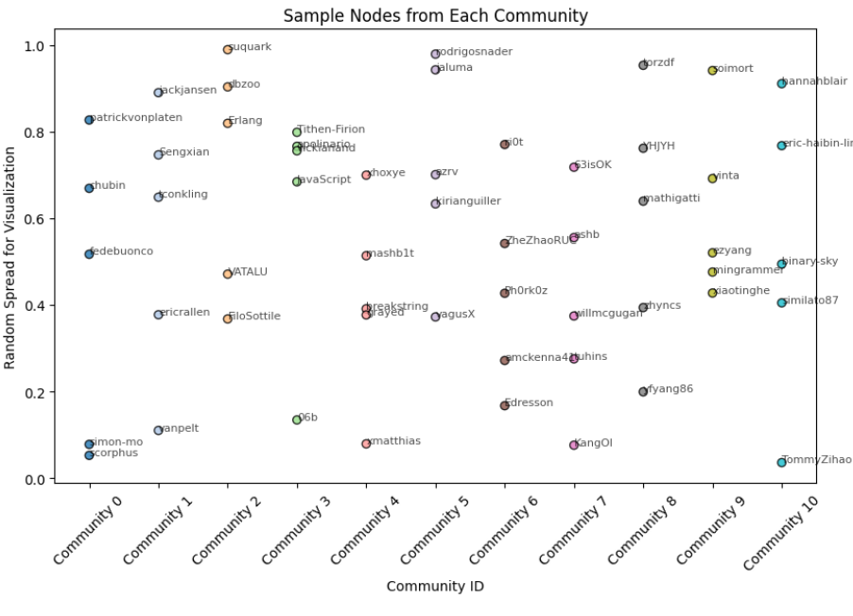
Community Detection(Louvain Algorithm)

Slide 10
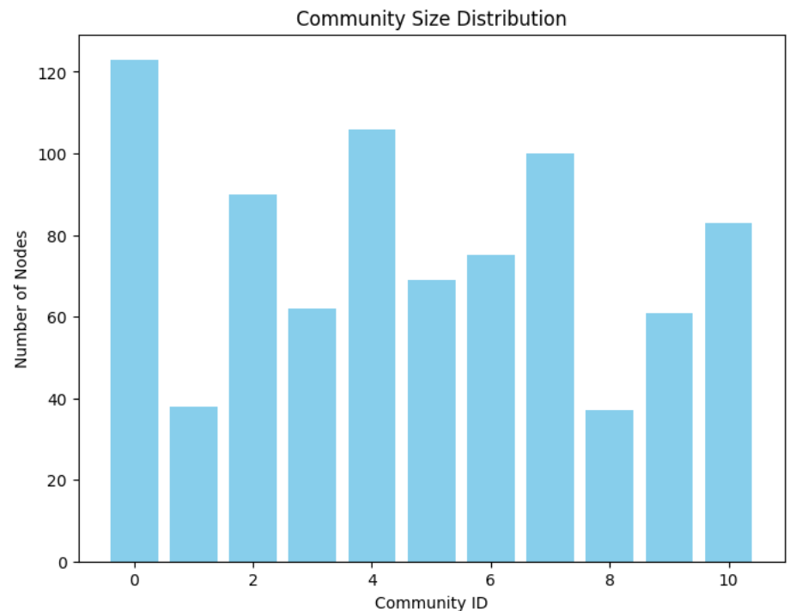
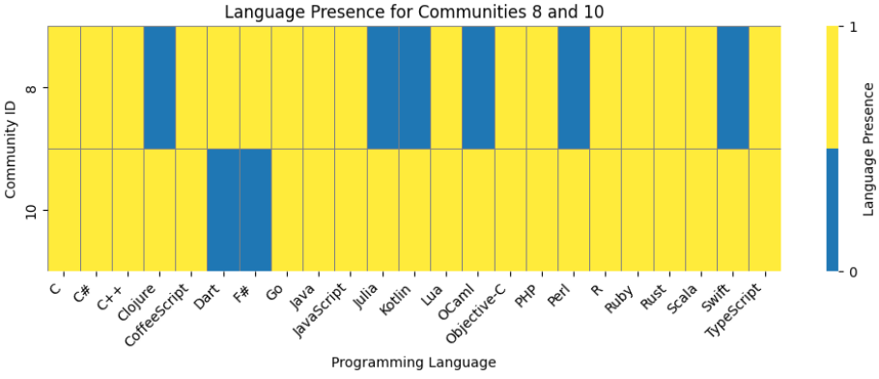
Community Detection
11 communities emerged, ranging from 37 to 123 nodes, reflecting developers who share similar cross-language interests.
These clusters could correspond to technology stacks like community 8 can be said to be data engineering focused and community 10 can be ML infrastructure/ mobile-backend data apps focused.

Slide 11
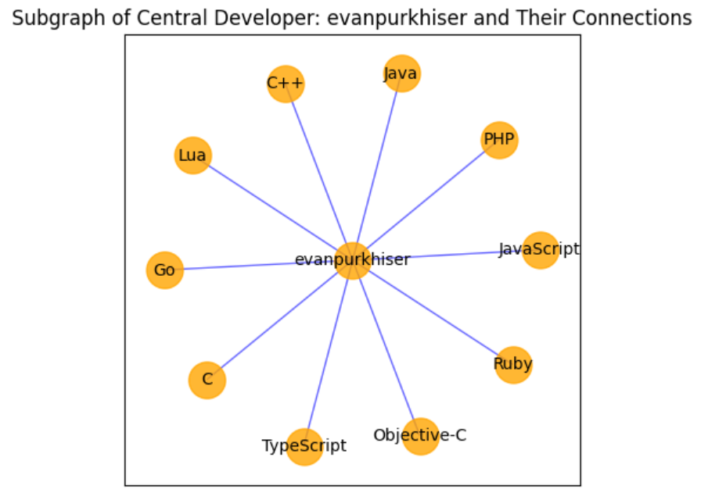
Betweenness Centrality
The highest among multilingual developers, indicating they sit on the most shortest path across language communities.
The developer bridges 10 language communities by being the shortest path across the network.

Slide 12
Impact
Enhanced Interoperability Developers contribute in various languages, enabling seamless integration of diverse systems (Django Rest backend with REACT js frontend)
The project analyzes GitHub collaboration networks and identifies communities of developers working in multiple languages.
By mapping these language intersections, it reveals how diverse tech stacks come together in real-world development.
Broader Collaboration & Innovation Cross-language teamwork encourages knowledge exchange, fostering creativity and richer software solutions.
through community detection and language profiling, the project highlights how multilingual teams form naturally.
This shows how developers with different language expertise collaborate, fostering innovation.

Slide 13
Thank you !
Questions ?

